Slide 1
Case Study Cyclistic Bike Share
30 November, 2021
Presented by :- Prakhar Shukla

Slide 2
Problem Statement
Company
Context
Context
Problem statement
Cyclistic: A bike-share program that features more than 5,800 bicycles and 600 docking stations. Cyclistic sets itself apart by also offering reclining bikes, hand tricycles, and cargo bikes, thus enabling their services to people with disabilities also.
The company wants to develop a plan to convert their casual users into annual members as that is more beneficial for the development of the company.
How do annual members and casual riders use Cyclistic bikes differently?
The results of this task along with other comparisons will be used in formulating a marketing strategy.

Slide 3
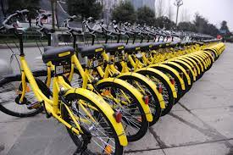
Analysis
November 2020 - November 2021
(The data that will be used in this study has been made available to us by Motivate International Inc under this license)

Slide 4
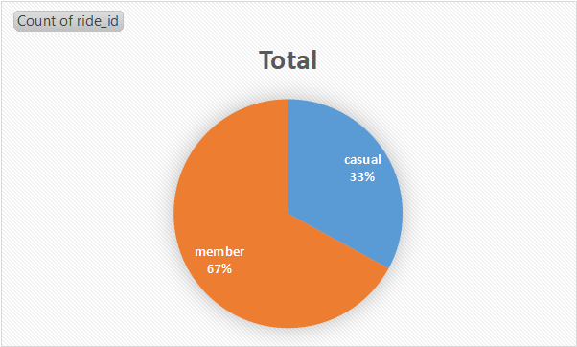
Ride Quota
Here we can see that the annual members occupy 34% more rides than the casual riders but...

Slide 5
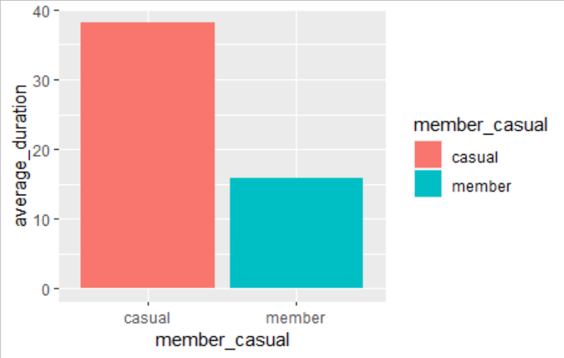
Average Duration of Trips
The average duration of trips of the casual members is nearly 3 time of the annual members, which shows that the casual members tend to go for longer trips compared to the annual members.

Slide 6
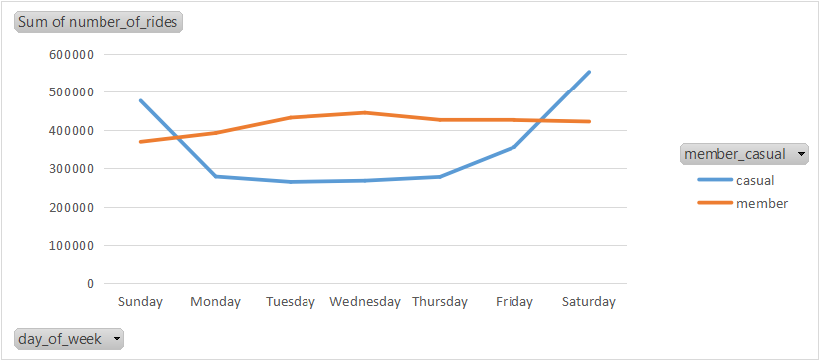
Weekly Stats of Number of Trips
Here we can spot that the number of casual riders increase tremendously on weekends, while the number of trips of the annual members are pretty much constant for the whole week.

Slide 7
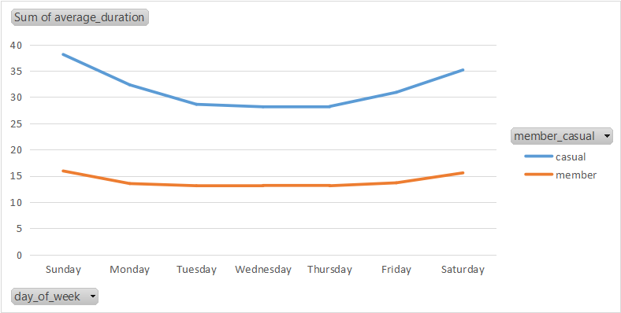
Weekly Stats of Average Duration of Trips
The average duration of trips of the annual members over the week is nearly constant whereas we can see that the graph of the casual members shows a spike near the end which can be attributed to the increase in the number of trips on the weekend.

Slide 8
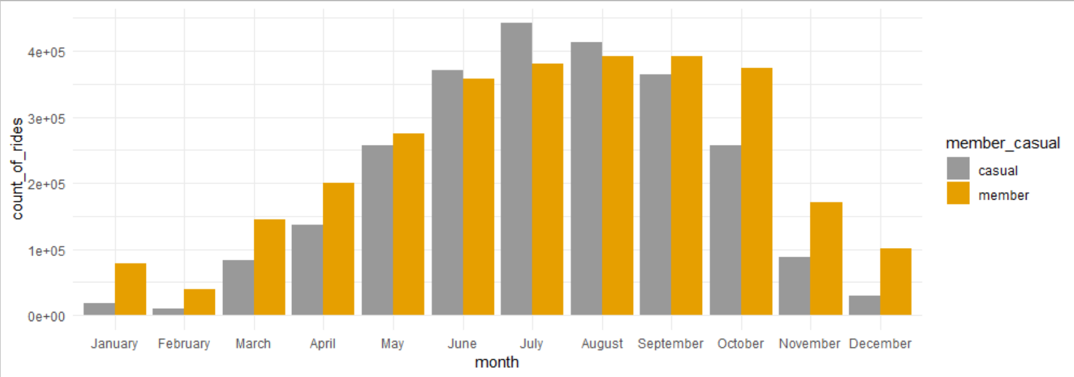
Monthly Stats of Number of Trips
Here we can see that the number of casual riders peaks during the months of June to September.
The number of annual members is also high during this period.

Slide 9
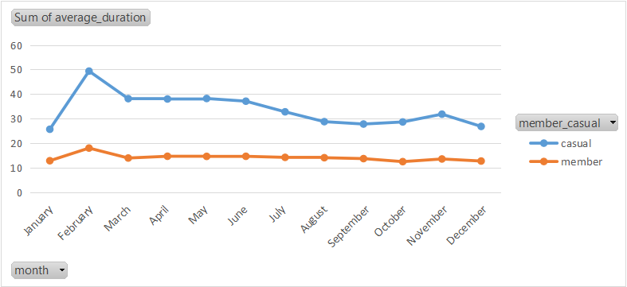
Monthly Stats of Duration of Trips
Here we can see that the average of duration of trips peaks in the month of february for both the casual and annual members.

Slide 10
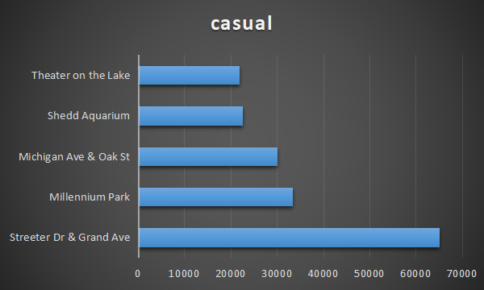
Station Stats
These are the 5 most commonly used stations by the casual riders.

Slide 11
Summary
Discovery - 1
Discovery - 2
Discovery - 3
The number of trips completed by casual rides is less but the duration of their trips is also higher than the annual members.
A lot of casual riders prefer to ride on weekends. They also like to travel between 4pm to 7pm a lot. The peak months for the casual riders are from June to September.
Casual riders mostly use the bikes for entertainment as they usually travel on weekends while annual members follow their routine.

Slide 12
Recommendations
After analysing the data we can :-
Design offers that for weekends, entertaining contests or other activities that can attract casual users.
Provide extra discounts on meeting daily quotas for using the bike service.
Provide offers that target the casual riders on most effectively places such as :-
Days :- Weekends, Months :- Feb and form June to September
Stations :- Streeter Dr & Grand Ave, Millennium Park, Michigan Ave & Oak St, Shedd Aquarium and Theater on the Lake
Design offers for travelling between 4pm to 7pm.

Slide 13
Thank You!
Prakhar Shukla
shuklap24@gmail.com
Github.com/Prakhar2499

